Slide 1

MY CARBON FOOTPRINT
Author’s Name
Class Name and Number

Slide 2
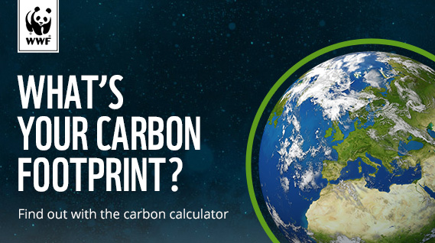
Carbon Footprint
Carbon footprint refers to the amount of carbon dioxide emitted into the atmosphere as a result of all daily activities of an individual, community, or an organization directly or indirectly.
Carbon footprint is important because it measures the output of carbon dioxide produced by a person or household. Therefore , carbon footprint provide a number for the carbon dioxide released. The larger the number means that carbon footprint of an individual is greater hence the greater their impact on global warming.

Slide 3
Results from ecological footprint quiz
If anyone would live like me we would only require 0.7 Earths.
31 May 2019 ,is the date I reach 1 Earth. Hence, there will be no Overshoot Day.
My lifestyle is that of an online student which does not involve a lot of movements from area to another.
Also, I work part-time online as a writer and blogger. The advantage of my part-time works is that they also do not require transportation since I have install internet in my home. Hence I can do all my studies and works from the comfort of my home. Therefore, this helps me not to use often most means of transport such as car, bus, train or plane.

Slide 4
Cont. of results
In terms of diet , I prefer to eat vegetables to red meat only once or twice a week do I incorporate fish or chicken. Though, I often use dairy products on a daily basis.
As a result, I ended up producing a low number of carbon footprint when compared to the scale of Earths from various countries ,for instance , U.S.A has 5 while Brazil has 1.

Slide 5
Areas I can lessen footprint
At the moment, am staying alone I will look for a partner or roommate to cost share.
The car that I use to commute sometimes is inefficient because it consume a lot of fuel.
Also , to lessen my carbon footprint instead of using the bus very often I will use a bicycle or walk.

Slide 6
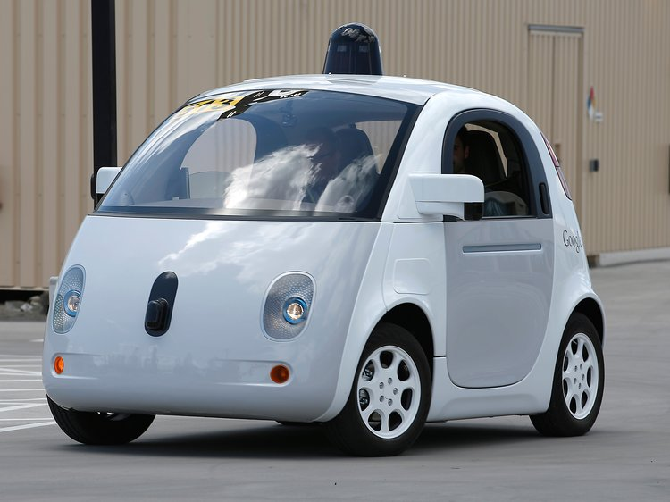
Ways to reduce my carbon footprint
Living alone is a cause for the increase of my carbon footprint. To reduce my carbon footprint I will look for another student so that we can share items such as electricity.
The car that I use to commute consumes 4liters of fuel in 100km.I have realized the need for an efficient or electric car because it aid in reduction of the fuel consumption ,thereby, producing less carbon dioxide.

Slide 7

Cont. of ways to reduce my carbon footprint
Lastly, I will start walking or riding bicycle to the shopping center instead of taking the bus. I usually use buses a lot when going shopping yet there are other ways that I can utilize .My carbon footprint will reduce if I stop using bus regularly, furthermore, I will be exercising my body through bicycling or walking .

Slide 8
The most effective ways reducing my carbon footprint from research
The distance that one drives matters. Reducing the average mileage of my car from 15,000 to 10,000 mile a year will save about 15% of the average person’s carbon footprint.
Also, if car travel is essential an individual should consider leasing an electric car .An electric car will help save money on fuel. However, though the electricity to charge the car will be partly produced in a coal or gas power station, electric car are much more efficient ,therefore, the total carbon dioxide emissions will fall..

Slide 9

Cont. of most effective ways
An individual should change their lifestyle and consume less meat, with specific emphasis on meals entailing lamp and beef. It is because sheep and cows emit large quantities of methane gas. A diet of vegetarian might make as much as a 20% decrease in one’s carbon effect.
When travelling or buying products it important for one to recycle as much as possible. Also, when shopping to an individual should buy items with minimal or recycle-able packaging .
I will achieve this by consistently and diligently applying the suggestions and methods provided on a day to day basis. For instance , I will be keen with the packaging of products when buying them and also lease electric car on a regular basis instead of using my car.

Slide 10
I will change my life to reduce my carbon footprint
First and foremost , I will stop using the bus on a regular occasion when going shopping . Instead , I will be cycling or walking since its not that far.
Secondly, I will either lease or buy an electric car. I will avoid using my car since it is not efficient.
Lastly, I will look for a roommate or partner hence we can cost share electricity bills and utilities.

Slide 11
References
Jones, C. M., & Kammen, D. M. (2011). Quantifying carbon footprint reduction opportunities for US households and communities. Environmental science & technology, 45(9), 4088-4095.
Goodall, C. (2010). How to live a low-carbon life: the individual's guide to tackling climate change. Routledge.
Paterson, M., & Stripple, J. (2010). My Space: governing individuals' carbon emissions. Environment and Planning D: Society and Space, 28(2), 341-362.

